Slide 1
Software Innovation Studio
Team 22
Graphics created by Ullupta conecum re volupta evelignis pe et doluptuam.

Slide 2
Team 22
Team | Roles
Clodagh | Back End Dev, Test
Beatrix | Front End Dev, ML Tribe
Jasmine | Front End Dev, UIUX
Tammy | Full Stack Dev, ML Tribe
Rupali | Full Stack Dev/ML Lead
Jerome | Front End Dev, Test
Katrina | Front End Dev, UIUX
Aims
Backend:
Develop logic magic Drive ML efforts and development
Frontend:
Develop app requirements based on Design
Design:
Create wireframes and consider UX Iterate on Design based on user / dev feedback
Test: Regularly test features based on acceptance criteria

Slide 3
1. Project Scope

Slide 4
Project Scope
Project Brief: A web application that uses ML to determine whether or not a particular item can be recycled based on council regulations in the user’s area.
Scope:
To identify whether certain soft plastics can be recycled using an Image Recognition Model
(Soft Plastic: a flexible plastic that is malleable in your hand i.e. ice cream wrappers)
Audience: People who want to recycle more consciously or have lack of knowledge with soft plastic recycling
Stretch Goal 1: Recognise material of item and identify whether it can be recycled through using Image Recognition Model
To focus on a specific area in NSW
Stretch Goal 2: Add incentive to encourage the user to use the application and be rewarded of their progress
Notes:
- Address the whole scope and objective clearly
- Please use non technical term. It means every audience (your parents or grand parents can also easily understand your bright idea will change the whole world)

Slide 5
2. Research

Slide 6
Background Research and Users’ Needs
Pain Point: Difference between Mobius Loop & PIC
84% to 96% are recycled from yellow bin, ~16% not recycled due to lack of knowledge
26% of Australians felt they had limited knowledge on recycling and soft plastics recycling (Wheeler, 2020)
Plastic is particularly confusing considering its various forms and disposal differences across different councils (FoodMag, 2020)
Targeting the 16% - 26% of Australians: Education + human centered process; off load the thinking to machines
Notes:
- Address the Users’ pain point(s) / need(s) / requirements with supported references
- The reference can be from news, daily life, research question …
- => Highlight the problem (s) / requirement (s) is (are) important and valuable
- The similar ideas, products or solutions in the market. What, why and how you can do better?

Slide 7
3. Prototype

Slide 8
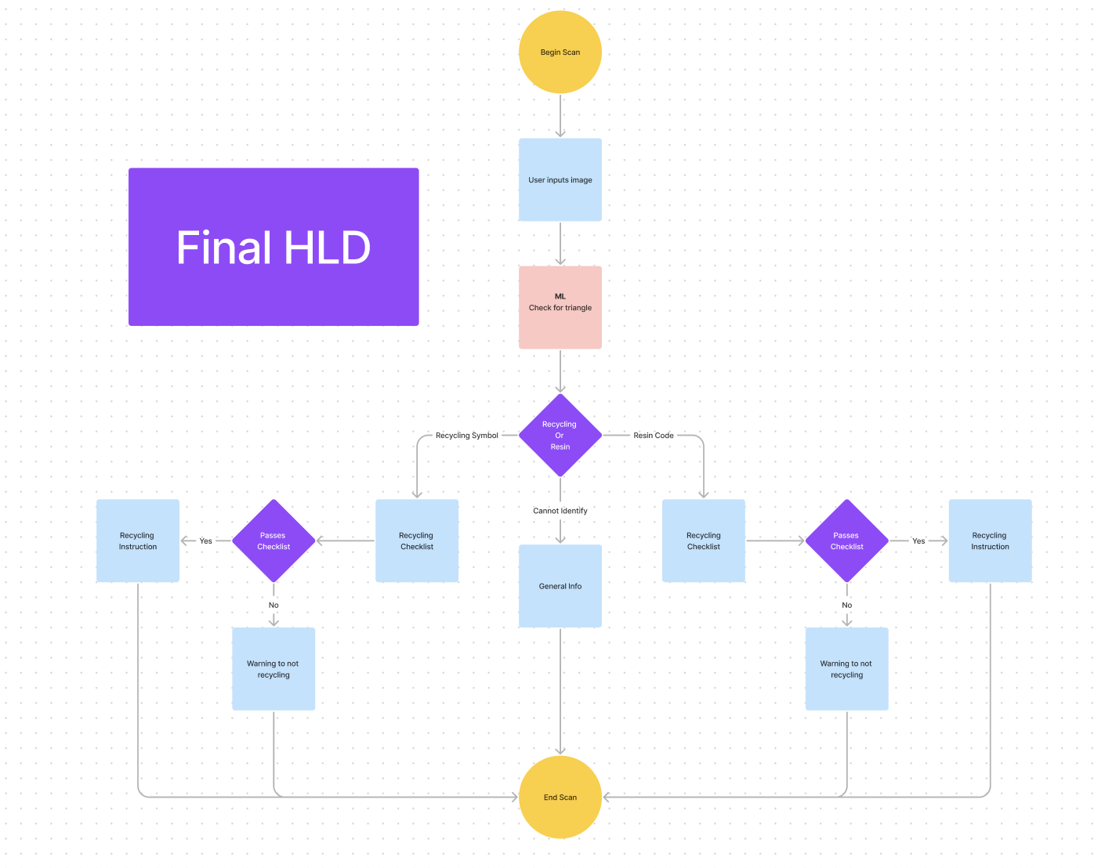
Expected Prototype / Achievements
Scans photo
Identifies symbol from the photo
Returns recycling instructions
and options based on region
Will recommend product alternatives based on material (if applicable)

Slide 9


Competing Products
Their Product (bad)
Our Product (good)
Inaccessible (IOS only)
Web app: can be accessed by any device
Relies too much on user input
Adaptable to different, region-based rules without relying on community input
Does nothing to address the introduction of single-use waste into a household
Helps end the cycle by recommending alternative products based on material type

Slide 10
4. Technical Composition

Slide 11
The Tech
Technical Component | What | Why
Machine Learning YOLOv8 (or similar) single shot | Symbol identification i.e. exact resin code or recycle symbol | High accuracy and simplified developer experience. Better identification and increased maintainability means agility for features.
Web | Application will be used on the web. | The web medium is available on most mobile devices (iOS and Android).
Notes:
Introduce the state-of-the-art tech which will be used or brought in your project
Why and how the tech can bring better product or solution to the end user?
Example: AR goggle => AR is a new way to provide interactive information to end user in real environment

Slide 12
5. Project Timeline & Deliverables

Slide 13
Project Timeline
Sprint Planning
Sprint 1
Environment Setup
Visual design discussed
Machine model in progress
Sprint 2
Machine model in progress
Machine training
Acceptance testing
Frontend development in progress
Sprint 3
Machine model complete
Integration into frontend in progress
Machine training
Acceptance testing
Sprint 4
Acceptance testing
Integration complete
Web app complete
High Level Achievements to complete throughout the semester
Machine model building (Triangular symbol recognition)
Machine training
Integration into web
Web application Finalised
Final Demonstration
Sprint Details
4 Sprints total; Ending 29th of October
2 Week sprints

Slide 14
Thank you

